Slide 1
Lecture 5
C Pointers
Dr. Nguyen Ngoc Truong Minh
School of Electrical Engineering
Vietnamese German University (VGU)
Spring 2014

Slide 2
OBJECTIVES
In this chapter you will learn:
Pointers and pointer operators.
To use pointers to pass arguments to functions by reference.
The close relationships among pointers, arrays and strings.
To use pointers to functions.
To define and use arrays of strings.

Slide 3
5.1 Introduction
5.2 Pointer Variable Definitions and Initialization
5.3 Pointer Operators
5.4 Passing Arguments to Functions by Reference
5.5 Using the const Qualifier with Pointers
5.6 Bubble Sort Using Call-by-Reference
5.7 sizeof Operator
5.8 Pointer Expressions and Pointer Arithmetic
5.9 Relationship between Pointers and Arrays
5.10 Arrays of Pointers
5.11 Case Study: Card Shuffling and Dealing Simulation
5.12 Pointers to Functions

Slide 4
5.1 Introduction
Pointers
Powerful, but difficult to master
Simulate call-by-reference
Close relationship with arrays and strings

Slide 5
5.2 Pointer Variable Definitions and Initialization
Pointer variables
Contain memory addresses as their values
Normal variables contain a specific value (direct reference)
Pointers contain address of a variable that has a specific value (indirect reference)
Indirection – referencing a pointer value

Slide 6
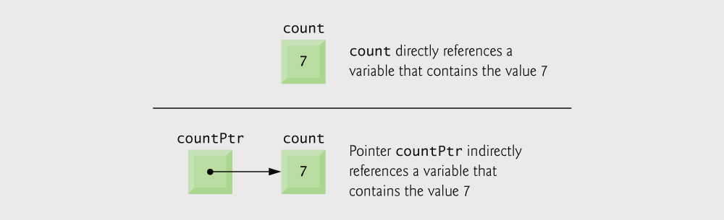
Fig. 5.1 | Directly and indirectly referencing a variable.

Slide 7
5.2 Pointer Variable Definitions and Initialization
Pointer definitions
* used with pointer variables
int *myPtr;
Defines a pointer to an int (pointer of type int *)
Multiple pointers require using a * before each variable definition
int *myPtr1, *myPtr2;
Can define pointers to any data type
Initialize pointers to 0, NULL, or an address
0 or NULL – points to nothing (NULL preferred)

Slide 8
Common Programming Error 5.1
The asterisk (*) notation used to declare pointer variables does not distribute to all variable names in a declaration. Each pointer must be declared with the * prefixed to the name; e.g., if you wish to declare xPtr and yPtr as int pointers, use int *xPtr, *yPtr;.

Slide 9
Good Programming Practice 5.1
Include the letters ptr in pointer variable names to make it clear that these variables are pointers and thus need to be handled appropriately.

Slide 10
Error-Prevention Tip 5.1
Initialize pointers to prevent unexpected results.

Slide 11
5.3 Pointer Operators
& (address operator)
Returns address of operand
int y = 5;
int *yPtr;
yPtr = &y; /* yPtr gets address of y */
yPtr “points to” y

Slide 12
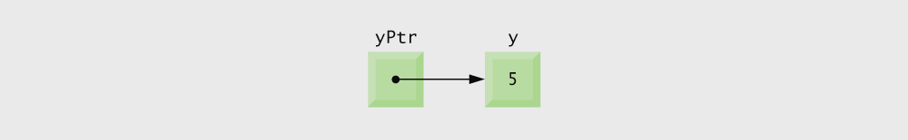
Fig. 5.2 | Graphical representation of a pointer pointing to an integer variable in memory.

Slide 13
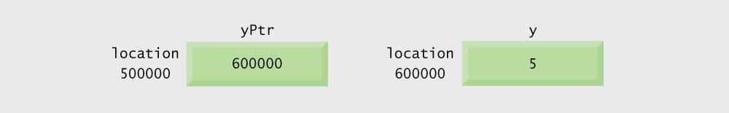
Fig. 5.3 | Representation of y and yPtr in memory.

Slide 14
5.3 Pointer Operators
* (indirection/dereferencing operator)
Returns a synonym/alias of what its operand points to
*yptr returns y (because yptr points to y)
* can be used for assignment
Returns alias to an object
*yptr = 7; /* changes y to 7 */
Dereferenced pointer (operand of *) must be an lvalue (no constants)
* and & are inverses
They cancel each other out

Slide 15
Common Programming Error 5.2
Dereferencing a pointer that has not been properly initialized or that has not been assigned to point to a specific location in memory is an error. This could cause a fatal execution-time error, or it could accidentally modify important data and allow the program to run to completion with incorrect results.

Slide 16
Outline
fig09_04.c
(1 of 2 )
If aPtr points to a, then &a and aPtr have the same value.
a and *aPtr have the same value
&*aPtr and *&aPtr have the same value

Slide 17
Outline
fig09_04.c
(2 of 2 )

Slide 18
Fig. 5.5 | Operator precedence.

Slide 19
5.4 Calling Functions by Reference
Call by reference with pointer arguments
Pass address of argument using & operator
Allows you to change actual location in memory
Arrays are not passed with & because the array name is already a pointer
* operator
Used as alias/nickname for variable inside of function
void double( int *number )
{
*number = 2 * ( *number );
}
*number used as nickname for the variable passed

Slide 20
Outline
fig09_06.c

Slide 21
Common Programming Error 5.3
Not dereferencing a pointer when it is necessary to do so in order to obtain the value to which the pointer points is a syntax error.

Slide 22
Outline
Function prototype takes a pointer argument
fig09_09.c
Function cubeByReference is passed an address, which can be the value of a pointer variable
In this program, *nPtr is number, so this statement modifies the value of number itself.

Slide 23
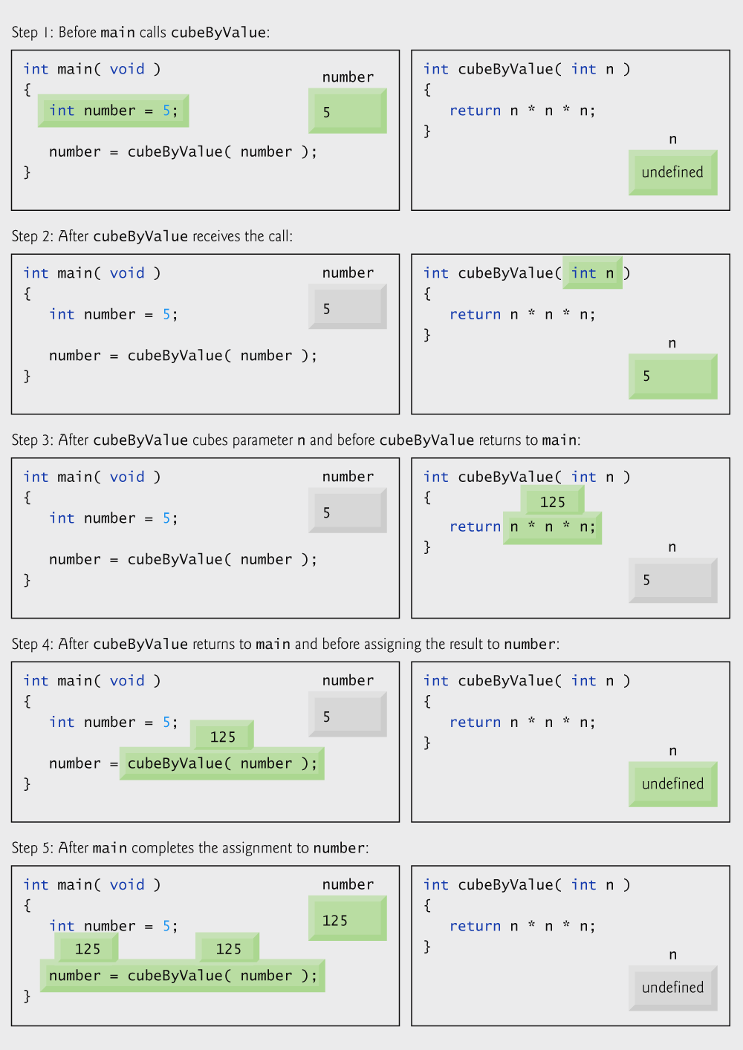
Fig. 5.8 | Analysis of a typical call-by-value.

Slide 24
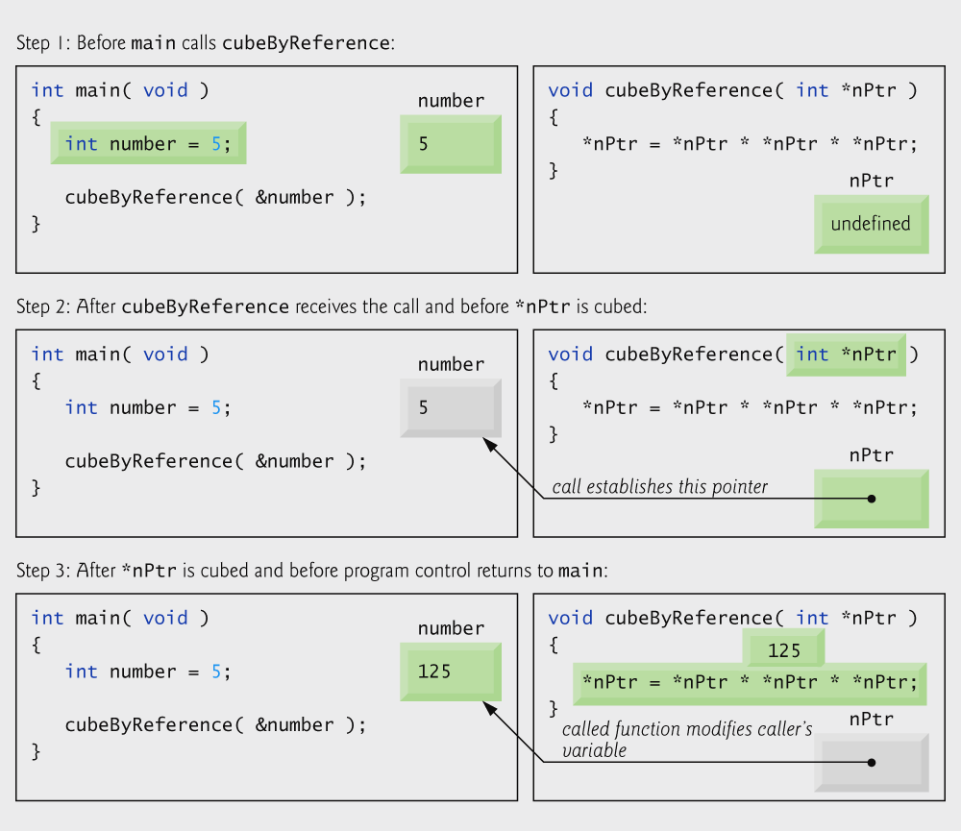
Fig. 5.9 | Analysis of a typical call-by-reference with a pointer argument.

Slide 25
Error-Prevention Tip 5.2
Use call-by-value to pass arguments to a function unless the caller explicitly requires the called function to modify the value of the argument variable in the caller’s environment. This prevents accidental modification of the caller’s arguments and is another example of the principle of least privilege.

Slide 26
5.5 Using the const Qualifier with Pointers
const qualifier
Variable cannot be changed
Use const if function does not need to change a variable
Attempting to change a const variable produces an error
const pointers
Point to a constant memory location
Must be initialized when defined
int *const myPtr = &x;
Type int *const – constant pointer to an int
const int *myPtr = &x;
Modifiable pointer to a const int
const int *const Ptr = &x;
const pointer to a const int
x itself can be changed, but not *Ptr

Slide 27
Software Engineering Observation 5.1
The const qualifier can be used to enforce the principle of least privilege. Using the principle of least privilege to properly design software reduces debugging time and improper side effects, making a program easier to modify and maintain.

Slide 28
Portability Tip 5.1
Although const is well defined in Standard C, some compilers do not enforce it.

Slide 29
Error-Prevention Tip 5.3
If a variable does not (or should not) change in the body of a function to which it is passed, the variable should be declared const to ensure that it is not accidentally modified.

Slide 30
Software Engineering Observation 5.2
Only one value can be altered in a calling function when call-by-value is used. That value must be assigned from the return value of the function. To modify multiple values in a calling function, call-by-reference must be used.

Slide 31
Error-Prevention Tip 5.4
Before using a function, check its function prototype to determine if the function is able to modify the values passed to it.

Slide 32
Common Programming Error 5.4
Being unaware that a function is expecting pointers as arguments for call-by-reference and passing arguments call-by-value. Some compilers take the values assuming they are pointers and dereference the values as pointers. At runtime, memory-access violations or segmentation faults are often generated. Other compilers catch the mismatch in types between arguments and parameters and generate error messages.

Slide 33
Outline
Both sPtr and *sPtr are modifiable
fig09_10.c
(1 of 2 )

Slide 34
Outline
fig09_10.c
(2 of 2 )
Both sPtr and *sPtr are modified by the convertToUppercase function

Slide 35
Outline
Pointer variable sPtr is modifiable, but the data to which it points, *sPtr, is not
fig09_11.c
(1 of 2 )

Slide 36
Outline
fig09_11.c
(2 of 2 )
sPtr is modified by function printCharacters

Slide 37
Outline
fig09_12.c
Pointer variable xPtr is modifiable, but the data to which it points, *xPtr, is not
*xPtr has the const qualifier, so attempting to modify its value causes an error

Slide 38
Performance Tip 5.1
Pass large objects such as structures using pointers to constant data to obtain the performance benefits of call-by-reference and the security of call-by-value.

Slide 39
Outline
fig09_13.c
Pointer ptr is not modifiable, but the data to which it points, *ptr, can be changed

Slide 40
Outline
fig09_14.c
Neither pointer sPtr nor the data to which it points, *sPtr, is modifiable

Slide 41
5.6 Bubble Sort Using Call-by-Reference
Implement bubble sort using pointers
Swap two elements
swap function must receive address (using &) of array elements
Array elements have call-by-value default
Using pointers and the * operator, swap can switch array elements
Psuedocode
Initialize array
print data in original order
Call function bubble sort
print sorted array
Define bubble sort

Slide 42
Outline
fig09_15.c
(1 of 3 )

Slide 43
Outline
fig09_15.c
(2 of 3 )

Slide 44
Outline
fig09_15.c
(3 of 3 )
Function swap changes the values of the ints that the two pointers point to

Slide 45
Software Engineering Observation 5.3
Placing function prototypes in the definitions of other functions enforces the principle of least privilege by restricting proper function calls to the functions in which the prototypes appear.

Slide 46
Software Engineering Observation 5.4
When passing an array to a function, also pass the size of the array. This helps make the function reusable in many programs.

Slide 47
Software Engineering Observation 5.5
Global variables usually violate the principle of least privilege and can lead to poor software engineering. Global variables should be used only to represent truly shared resources, such as the time of day.

Slide 48
5.7 sizeof Operator
sizeof
Returns size of operand in bytes
For arrays: size of 1 element * number of elements
if sizeof( int ) equals 4 bytes, then
int myArray[ 10 ];
printf( "%d", sizeof( myArray ) );
will print 40
sizeof can be used with
Variable names
Type name
Constant values

Slide 49
Outline
fig09_16.c
floats take up 4 bytes in memory, so 20 floats take up 80 bytes

Slide 50
Performance Tip 5.2
sizeof is a compile-time operator, so it does not incur any execution-time overhead.

Slide 51
Portability Tip 5.2
The number of bytes used to store a particular data type may vary between systems. When writing programs that depend on data type sizes and that will run on several computer systems, use sizeof to determine the number of bytes used to store the data types.

Slide 52
Outline
fig09_19.c
(1 of 2 )

Slide 53
Outline
fig09_19.c
(2 of 2 )

Slide 54
5.8 Pointer Expressions and Pointer Arithmetic
Arithmetic operations can be performed on pointers
Increment/decrement pointer (++ or --)
Add an integer to a pointer( + or += , - or -=)
Pointers may be subtracted from each other
Operations meaningless unless performed on an array

Slide 55
5.8 Pointer Expressions and Pointer Arithmetic
5 element int array on machine with 4 byte ints
vPtr points to first element v[ 0 ]
at location 3000 (vPtr = 3000)
vPtr += 2; sets vPtr to 3008
vPtr points to v[ 2 ] (incremented by 2), but the machine has 4 byte ints, so it points to address 3008

Slide 56
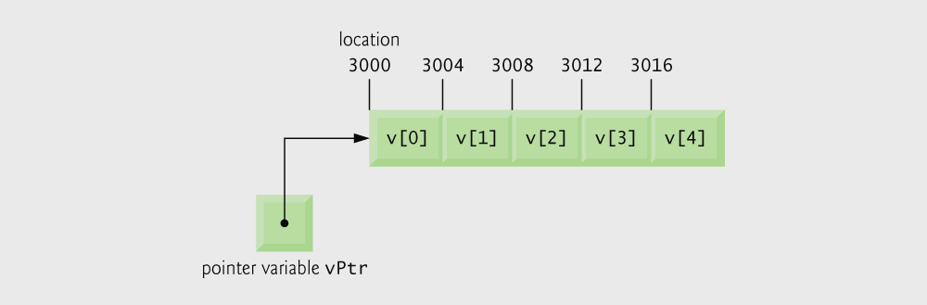
Fig. 5.18 | Array v and a pointer variable vPtr that points to v.

Slide 57
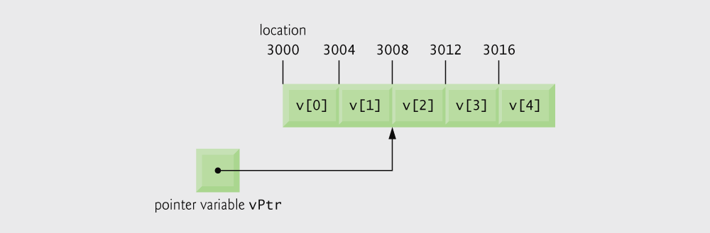
Fig. 5.19 | The pointer vPtr after pointer arithmetic.

Slide 58
Portability Tip 5.3
Most computers today have 2-byte or 4-byte integers. Some of the newer machines use 8-byte integers. Because the results of pointer arithmetic depend on the size of the objects a pointer points to, pointer arithmetic is machine dependent.

Slide 59
5.8 Pointer Expressions and Pointer Arithmetic
Subtracting pointers
Returns number of elements from one to the other. If
vPtr2 = v[ 2 ];
vPtr = v[ 0 ];
vPtr2 - vPtr would produce 2
Pointer comparison ( <, == , > )
See which pointer points to the higher numbered array element
Also, see if a pointer points to 0

Slide 60
Common Programming Error 5.5
Using pointer arithmetic on a pointer that does not refer to an element in an array.

Slide 61
Common Programming Error 5.6
Subtracting or comparing two pointers that do not refer to elements in the same array.

Slide 62
Common Programming Error 5.7
Running off either end of an array when using pointer arithmetic.

Slide 63
5.8 Pointer Expressions and Pointer Arithmetic
Pointers of the same type can be assigned to each other
If not the same type, a cast operator must be used
Exception: pointer to void (type void *)
Generic pointer, represents any type
No casting needed to convert a pointer to void pointer
void pointers cannot be dereferenced

Slide 64
Common Programming Error 5.8
Assigning a pointer of one type to a pointer of another type if neither is of type void * is a syntax error.

Slide 65
Common Programming Error 5.9
Dereferencing a void * pointer is a syntax error.

Slide 66
5.9 Relationship Between Pointers and Arrays
Arrays and pointers closely related
Array name like a constant pointer
Pointers can do array subscripting operations
Define an array b[ 5 ] and a pointer bPtr
To set them equal to one another use:
bPtr = b;
The array name (b) is actually the address of first element of the array b[ 5 ]
bPtr = &b[ 0 ]
Explicitly assigns bPtr to address of first element of b

Slide 67
5.9 Relationship Between Pointers and Arrays
Element b[ 3 ]
Can be accessed by *( bPtr + 3 )
Where 3 is called the offset. Called pointer/offset notation
Can be accessed by bptr[ 3 ]
Called pointer/subscript notation
bPtr[ 3 ] same as b[ 3 ]
Can be accessed by performing pointer arithmetic on the array itself
*( b + 3 )

Slide 68
Common Programming Error 5.10
Attempting to modify an array name with pointer arithmetic is a syntax error.

Slide 69
Outline
fig09_20.c
(1 of 3 )
Array subscript notation
Pointer/offset notation

Slide 70
Outline
Pointer subscript notation
fig09_20.c
(2 of 3 )
Pointer offset notation

Slide 71
Outline
fig09_20.c
(3 of 3 )

Slide 72
Outline
fig09_21.c
(1 of 2 )

Slide 73
Outline
fig09_21.c
(2 of 2 )
Condition of for loop actually performs an action

Slide 74
9.10 Arrays of Pointers
Arrays can contain pointers
For example: an array of strings
char *suit[ 4 ] = { "Hearts", "Diamonds", "Clubs", "Spades" };
Strings are pointers to the first character
char * – each element of suit is a pointer to a char
The strings are not actually stored in the array suit, only pointers to the strings are stored

Slide 75
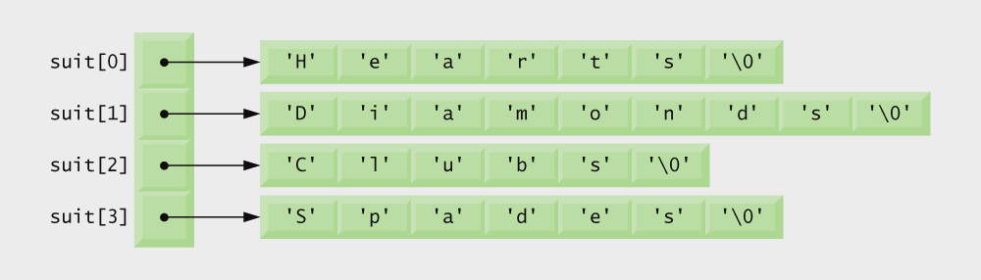
Fig. 9.22 | Graphical representation of the suit array.

Slide 76
9.11 Case Study: Card Shuffling and Dealing Simulation
Card shuffling program
Use array of pointers to strings
Use double subscripted array (suit, face)
The numbers 1-52 go into the array
Representing the order in which the cards are dealt

Slide 77
Performance Tip 9.3
Sometimes an algorithm that emerges in a “natural” way can contain subtle performance problems, such as indefinite postponement. Seek algorithms that avoid indefinite postponement.

Slide 78
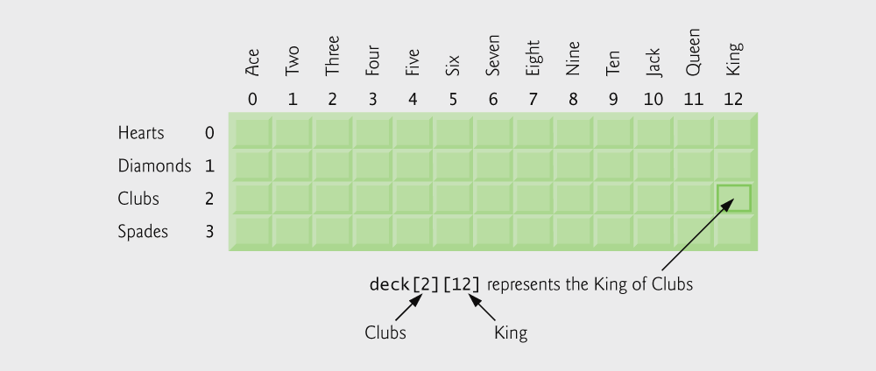
Fig. 9.23 | Double-subscripted array representation of a deck of cards.

Slide 79
9.11 Case Study: Card Shuffling and Dealing Simulation
Pseudocode
Top level:
Shuffle and deal 52 cards
First refinement:
Initialize the suit array
Initialize the face array
Initialize the deck array
Shuffle the deck
Deal 52 cards

Slide 80
9.11 Case Study: Card Shuffling and Dealing Simulation
Second refinement
Convert shuffle the deck to
For each of the 52 cards Place card number in randomly selected unoccupied slot of deck
Convert deal 52 cards to
For each of the 52 cards Find card number in deck array and print face and suit of card

Slide 81
9.11 Case Study: Card Shuffling and Dealing Simulation
Third refinement
Convert shuffle the deck to
Choose slot of deck randomly
While chosen slot of deck has been previously chosen Choose slot of deck randomly
Place card number in chosen slot of deck
Convert deal 52 cards to
For each slot of the deck array If slot contains card number Print the face and suit of the card

Slide 82
Outline
fig09_24.c
(1 of 4 )
suit and face arrays are arrays of pointers

Slide 83
Outline
fig09_24.c
(2 of 4 )
do…while loop selects a random spot for each card

Slide 84
Outline
fig09_24.c
(3 of 4 )

Slide 85
Outline
fig09_24.c
(4 of 4 )

Slide 86
Outline

Slide 87
9.12 Pointers to Functions
Pointer to function
Contains address of function
Similar to how array name is address of first element
Function name is starting address of code that defines function
Function pointers can be
Passed to functions
Stored in arrays
Assigned to other function pointers

Slide 88
9.12 Pointers to Functions
Example: bubblesort
Function bubble takes a function pointer
bubble calls this helper function
this determines ascending or descending sorting
The argument in bubblesort for the function pointer:
int ( *compare )( int a, int b )
tells bubblesort to expect a pointer to a function that takes two ints and returns an int
If the parentheses were left out:
int *compare( int a, int b )
Defines a function that receives two integers and returns a pointer to a int

Slide 89
Outline
fig09_26.c
(1 of 4 )
bubble function takes a function pointer as an argument

Slide 90
Outline
fig09_26.c
(2 of 4 )
depending on the user’s choice, the bubble function uses either the ascending or descending function to sort the array

Slide 91
Outline
fig09_26.c
(3 of 4 )
Note that what the program considers “out of order” is dependent on the function pointer that was passed to the bubble function

Slide 92
Outline
fig09_26.c
(4 of 4 )
Passing the bubble function ascending will point the program here
Passing the bubble function descending will point the program here

Slide 93
Outline

Slide 94
Outline
fig09_28.c
(1 of 3 )
Array of pointers to functions

Slide 95
Outline
Function called is dependent on user’s choice
fig09_28.c
(2 of 3 )

Slide 96
Outline
fig09_28.c
(3 of 3 )

Slide 97
Structures
Lecture 7
Dr. Nguyen Ngoc Truong Minh
School of Electrical Engineering
Vietnamese German University (VGU)
Spring 2014

Slide 98
Structures (1)
Structures are C’s way of grouping collections of data into a single manageable unit.
This is also the fundamental element of C upon which most of C++ is built (i.e., classes).
Similar to Java's classes.
An example:
Defining a structure type:
struct coord { int x ; int y ;
};
This defines a new type struct coord. No variable is actually declared or generated.

Slide 99
Structures (2)
Define struct variables:
struct coord { int x,y ; } first, second;
Another Approach:
struct coord { int x,y ; };
...............
struct coord first, second; /* declare variables */
struct coord third;

Slide 100
Structures (3)
You can even use a typedef if your don't like having to use the word “struct”
typedef struct coord coordinate;
coordinate first, second;
In some compilers, and all C++ compilers, you can usually simply say just:
coord first, second;

Slide 101
Structures (4)
Access structure variables by the dot (.) operator
Generic form:
structure_var.member_name
For example:
first.x = 50 ;
second.y = 100;
These member names are like the public data members of a class in Java (or C++).
No equivalent to function members/methods.
struct_var.member_name can be used anywhere a variable can be used:
printf ("%d , %d", second.x , second.y );
scanf("%d, %d", &first.x, &first.y);

Slide 102
Structures (5)
You can assign structures as a unit with =
first = second;
instead of writing:
first.x = second.x ; first.y = second.y ;
Although the saving here is not great
It will reduce the likelihood of errors and
is more convenient with large structures
This is different from Java where variables are simply references to objects.
first = second;
makes first and second refer to the same object.

Slide 103
Structures Containing Structures
Any “type” of thing can be a member of a structure.
We can use the coord struct to define a rectangle
struct rectangle {
struct coord topleft;
struct coord bottomrt;
} ;
This describes a rectangle by using the two points necessary:
struct rectangle mybox ;
Initializing the points:
mybox.topleft.x = 0 ;
mybox.topleft.y = 10 ;
mybox.bottomrt.x = 100 ;
mybox.bottomrt.y = 200 ;

Slide 104
An Example
int main () {
int length, width;
long area;
struct rectangle mybox;
mybox.topleft.x = 0;
mybox.topleft.y = 0;
mybox.bottomrt.x = 100;
mybox.bottomrt.y = 50;
width = mybox.bottomrt.x –
mybox.topleft.x;
length = mybox.bottomrt.y –
mybox.topleft.y;
area = width * length;
printf ("The area is %ld units.\n", area);
}
#include <stdio.h>
struct coord {
int x;
int y;
};
struct rectangle {
struct coord topleft;
struct coord bottomrt;
};

Slide 105
Structures Containing Arrays
Arrays within structures are the same as any other member element.
For example:
struct record { float x;
char y [5] ; } ;
Logical organization:
record
float
char[5]

Slide 106
An Example
#include <stdio.h>
struct data {
float amount;
char fname[30];
char lname[30];
} rec;
int main () {
struct data rec;
printf ("Enter the donor's first and last names, \n");
printf ("separated by a space: ");
scanf ("%s %s", rec.fname, rec.lname);
printf ("\nEnter the donation amount: ");
scanf ("%f", &rec.amount);
printf ("\nDonor %s %s gave $%.2f.\n",
rec.fname,rec.lname,rec.amount);
}

Slide 107
Arrays of Structures
The converse of a structure with arrays:
Example:
struct entry {
char fname [10] ;
char lname [12] ;
char phone [8] ;
} ;
struct entry list [1000];
This creates a list of 1000 identical entry(s).
Assignments:
list [1] = list [6];
strcpy (list[1].phone, list[6].phone);
list[6].phone[1] = list[3].phone[4] ;

Slide 108
An Example
#include <stdio.h>
struct entry {
char fname [20];
char lname [20];
char phone [10];
} ;
int main() {
struct entry list[4];
int i;
for (i=0; i < 4; i++) {
printf ("\nEnter first name: ");
scanf ("%s", list[i].fname);
printf ("Enter last name: ");
scanf ("%s", list[i].lname);
printf ("Enter phone in 123-4567 format: ");
scanf ("%s", list[i].phone);
}
printf ("\n\n");
for (i=0; i < 4; i++) {
printf ("Name: %s %s", list[i].fname, list[i].lname);
printf ("\t\tPhone: %s\n", list[i].phone);
}
}

Slide 109
Initializing Structures
Simple example:
struct sale {
char customer [20] ;
char item [20] ;
int amount ;
};
struct sale mysale = { "Acme Industries",
"Zorgle blaster",
1000 } ;

Slide 110
Initializing Structures
Structures within structures:
struct customer {
char firm [20] ;
char contact [25] ;
};
struct sale {
struct customer buyer ;
char item [20] ;
int amount ;
} mysale =
{ { "Acme Industries", "George Adams"} ,
"Zorgle Blaster", 1000
} ;

Slide 111
Initializing Structures
Arrays of structures
struct customer {
char firm [20] ;
char contact [25] ;
} ;
struct sale {
struct customer buyer ;
char item [20] ;
int amount ;
} ;
struct sale y1990 [100] = {
{ { "Acme Industries", "George Adams"} ,
"Left-handed Idiots" , 1000
},
{ { "Wilson & Co.",
"Ed Wilson"} ,
"Thingamabob" , 290
}
} ;

Slide 112
Pointers to Structures
struct part { float price ; char name [10] ;
} ;
struct part *p , thing;
p = &thing;
/* The following three statements are equivalent */
thing.price = 50;
(*p).price = 50; /* () around *p is needed */
p -> price = 50;

Slide 113
Pointers to Structures
thing.price
thing.name [ ]
p
p is set to point to the first byte of the struct variable

Slide 114
Pointers to Structures
struct part * p, *q;
p = (struct part *) malloc( sizeof(struct part) );
q = (struct part *) malloc( sizeof(struct part) );
p -> price = 199.99 ;
strcpy( p -> name, "hard disk" );
(*q) = (*p);
q = p;
free(p);
free(q); /* This statement causes a problem !!! Why? */

Slide 115
Pointers to Structures
You can allocate a structure array as well:
{
struct part *ptr;
ptr = (struct part *) malloc(10 * sizeof(struct part) );
for( i=0; i< 10; i++)
{
ptr[ i ].price = 10.0 * i;
sprintf( ptr[ i ].name, "part %d", i );
}
……
free(ptr);
}

Slide 116
Pointers to Structures
You can use pointer arithmetic to access the elements of the array:
{
struct part *ptr, *p;
ptr = (struct part *) malloc(10 * sizeof(struct part) );
for( i=0, p=ptr; i< 10; i++, p++)
{
p -> price = 10.0 * i;
sprintf( p -> name, "part %d", i );
}
……
free(ptr);
}

Slide 117
Pointer as Structure Member
struct node{
int data;
struct node *next;
};
struct node a,b,c;
a.next = &b;
b.next = &c;
c.next = NULL;
a.data = 1;
a.next->data = 2;
/* b.data =2 */
a.next->next->data = 3;
/* c.data = 3 */
c.next = (struct node *) malloc(sizeof(struct node));
……
NULL
a
b
c

Slide 118
Assignment Operator vs. memcpy
Equivalently, you can use memcpy
#include <string.h>
……
{
struct part a,b;
b.price = 39.99;
b.name = "floppy";
memcpy(&a,&b,sizeof(part));
}
This assigns a struct to another
{
struct part a,b;
b.price = 39.99;
b.name = "floppy";
a = b;
}

Slide 119
Array Member vs. Pointer Member
int main()
{
struct book a,b;
b.price = 19.99;
strcpy(b.name, "C handbook");
a = b;
strcpy(b.name, "Unix handbook");
puts(a.name);
puts(b.name);
}
struct book {
float price;
char name[50];
};

Slide 120
Array Member vs. Pointer Member
int main()
{
struct book a,b;
b.price = 19.99;
b.name = (char *) malloc(50);
strcpy(b.name, "C handbook");
a = b;
strcpy(b.name, "Unix handbook");
puts(a.name);
puts(b.name);
free(b.name);
}
struct book {
float price;
char *name;
};
A function called strdup() will do the malloc() and strcpy() in one step for you!

Slide 121
Passing Structures to Functions (1)
Structures are passed by value to functions
The parameter variable is a local variable, which will be assigned by the value of the argument passed.
This means that the structure is copied if it is passed as a parameter.
This can be inefficient if the structure is big.
In this case it may be more efficient to pass a pointer to the struct.
A struct can also be returned from a function.

Slide 122
Passing Structures to Functions (2)
struct book {
float price;
char abstract[5000];
};
void print_abstract( struct book *p_book)
{
puts( p_book->abstract );
};
struct pairInt {
int min, max;
};
struct pairInt min_max(int x,int y)
{
struct pairInt pair;
pair.min = (x > y) ? y : x;
pair.max = (x > y) ? x : y;
return pairInt;
}
int main(){
struct pairInt result;
result = min_max( 3, 5 );
printf("%d<=%d", result.min, result.max);
}

Slide 123
Structure
Union
1.The keyword struct is used to define a structure
1. The keyword union is used to define a union.
2. When a variable is associated with a structure, the compiler allocates the memory for each member. The size of structure is greater than or equal to the sum of sizes of its members. The smaller members may end with unused slack bytes.
2. When a variable is associated with a union, the compiler allocates the memory by considering the size of the largest memory. So, size of union is equal to the size of largest member.
3. Each member within a structure is assigned unique storage area of location.
3. Memory allocated is shared by individual members of union.
4. The address of each member will be in ascending order This indicates that memory for each member will start at different offset values.
4. The address is same for all the members of a union. This indicates that every member begins at the same offset value.
5 Altering the value of a member will not affect other members of the structure.
5. Altering the value of any of the member will alter other member values.
6. Individual member can be accessed at a time
6. Only one member can be accessed at a time.
7. Several members of a structure can initialize at once.
7. Only the first member of a union can be initialized.

Slide 124
END OF THIS TUTORIAL

